Slide 1

Bank Marketing Campaign
Taimoor Razi
Akshar Chaklashiya
Ogwu Augustine
Date: 15-09-2022
Notes:
Hello and welcome, my name is Taimoor Razi and today me and my team members, Akshar Chaklashiya and Ogwu Augustine will be presenting to you the results of the Data Glacier Team on our clients Bank Marketing Campaign.

Slide 2
Outline
Executive Summary
Problem Statement
Approach
Data Overview
Exploratory Data Analysis (EDA)
EDA Summary
Recommendations
Notes:
Today’s outline will be as follows:
1. We will give the executive summary and describe the problem statement of the project to give a high level understanding of the business problem we're tackling and the specific requirements.
2. I will then go over the approach that we followed to complete this task, so that you have complete clarity in how we tackle these kinds of tasks.
3. Then, Akshar will go over the Data Analysis we performed and all important results and he will present them as a series of insights and visualizations from our analysis.
4. To wrap up, August will summarize and give recommendations and proposed the ML models to proceed further in the ML pipeline. Finally, our team will be open for any questions.

Slide 3
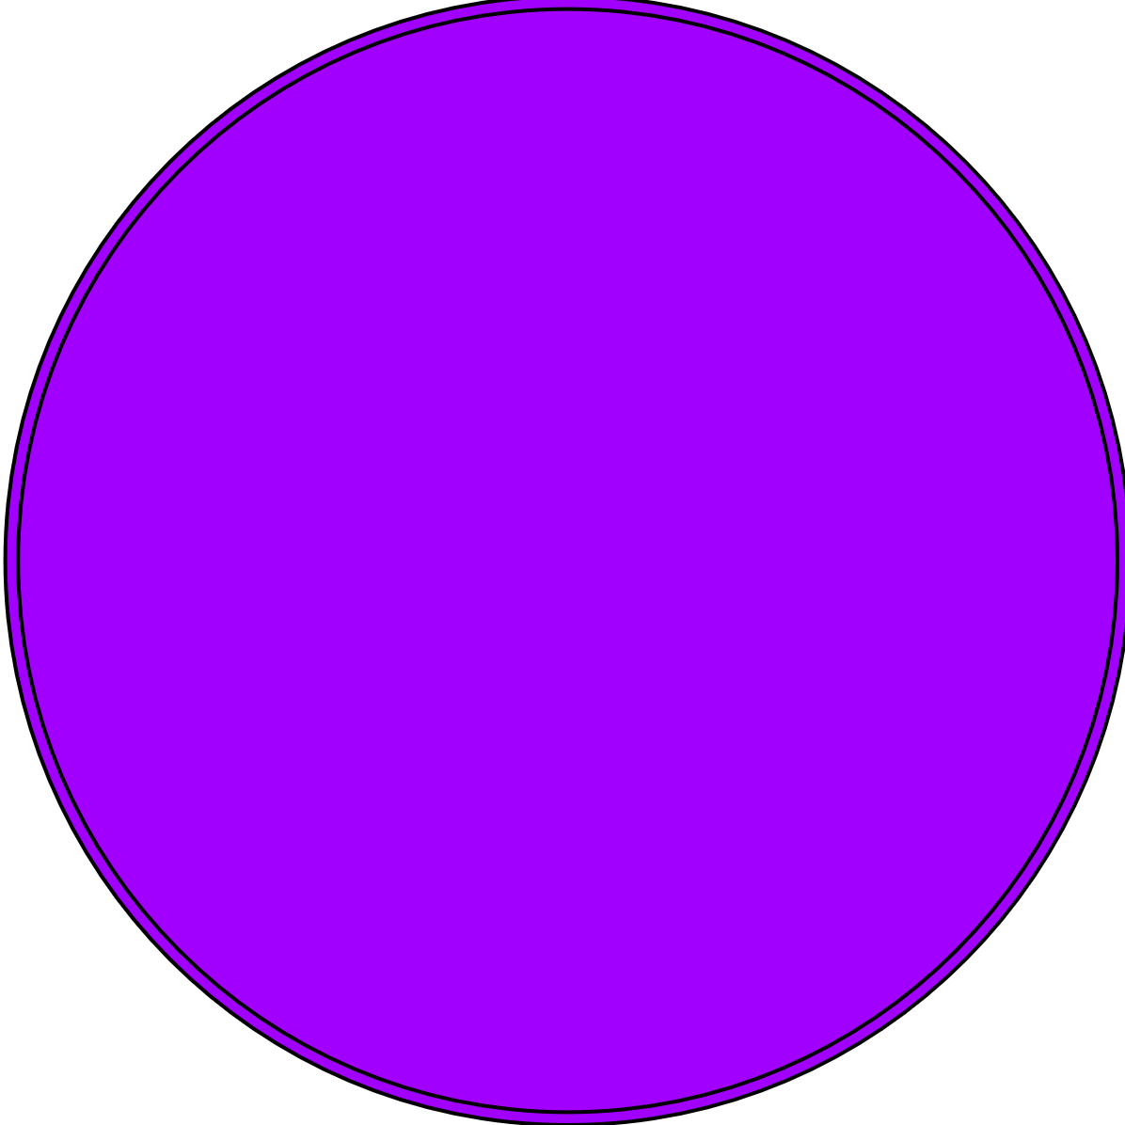
ABC Bank wants to sell it's term deposit product to customers and before launching the product they want to develop a model which help them in understanding whether a particular customer will buy their product or not (based on customer's past interaction with bank or other Financial Institution).
Executive Summary
Bank wants to use ML model to shortlist customer whose chances of buying the product is more so that their marketing channel (tele marketing, SMS/email marketing etc) can focus only to those customers whose chances of buying the product is more.
Notes:
To kick things off let me recap this engagement.
ABC Bank wants to sell it's term deposit product to customers and before launching the product they want to develop a model which help them in understanding whether a particular customer will buy their product or not (based on customer's past interaction with bank or other Financial Institution).
We, Data Glacier are here to help you understand the market and guide you in the right direction.

Slide 4
Data Glacier Objective : Provide actionable insights to help XYZ firm in identifying the right customers for targeting the marketing campaign.
This will save resource and their time ( which is directly involved in the cost ( resource billing)).
Data Glacier did a 1 month pilot focusing on these tasks:
Data Intake Report
EDA Notebook
ML Model Proposal
Presentation to ABC’s Executive team (Today)
Problem Statement
Notes:
Our Objective was to provide actionable insights to help ABC Bank in identifying the right customers for targeting the marketing campaign.
So, we embarked on a 1 month pilot with ABC Bank to focus on 3 main tasks.
Data Intake Report
EDA Notebook
ML model Proposal
Presentation to ABC’s Executive team which we are here today to present

Slide 5


1
Data Understanding and Extraction
Approach
2
Data Cleaning/Modelling
3
Exploratory Data Analysis
4
Recommendations
5
ML Model Proposal
Notes:
So, how did we tackle this problem?
Well we approached it in 5 steps:
1. Data understanding - the key to success on any data project is to understand the data in detail. So we took the time to understand the data model and domain of the business you are interested in.
2. Data extraction - after understanding your business, we then architected what an ideal dataset should look like for this problem and extracted it from the relevant data sources.
3. After extracting the raw data, we needed to process and model this data into a dataset that can precisely answer the business questions and produce analytics.
4. With our new dataset, we used our analytical expertise to uncover insights from this dataset and to produce visualizations to describe the insights.
5. And finally we used these insights to unlock business decisions and to make recommendations on next steps. We also included ML Model proposal at the end of the presentation to get your reviews/feedback before proceeding further to the next stage of model building and preparation.

Slide 6
Data Overview
UCI ML Repository
bank-additional-full.csv
Notes:
Lets make a quick Data overview. Since today we are here to focus on the analysis and insight, I will quickly go through the Data Overview.
After understanding the data needed for us to make the Analysis we extracted 1 dataset from UCI ML Repository which was used to perform analysis.

Slide 7
Bank Data
21 Features
Data Overview
41188 data points
5834924 bytes
Notes:
The resulted dataset had 21 features i.e., columns and 41188 data points i.e., rows with a total size of 5834924 bytes. Also note that in addition to our original 21 features we created some new features to help with our analysis. One of these features was month-day. Data Cleaning And Transformation was then done which is outside the scope of todays presentation.

Slide 8
The Exploratory Data Analysis (EDA) has been divided into four parts:
Market Overview: Categorical and Numerical Variable Analysis
Target Variable Analysis
Correlation Analysis
Time Series Analysis
Exploratory Data Analysis (EDA)
Notes:
Now to the most important part of the day, EDA. We divided the EDA into 4 parts. First we did a market overview by doing a categorical and numerical variable analysis. Then we did Target variable analysis to compare the subscribers and non-subscribers. Then a small correlation analysis was done to pull out one important information. Finally, we did a Time Series analysis to see when do the most people subscribe to the term deposit.

Slide 9
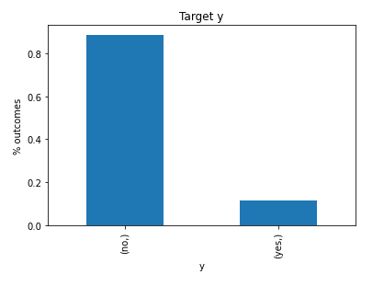
Target variable Analysis
An imbalance in the target variable.
An oversampling technique must be applied before model building
Notes:
There are some points to be noted from the categorical variables
1.
2.
3.
4.

Slide 10
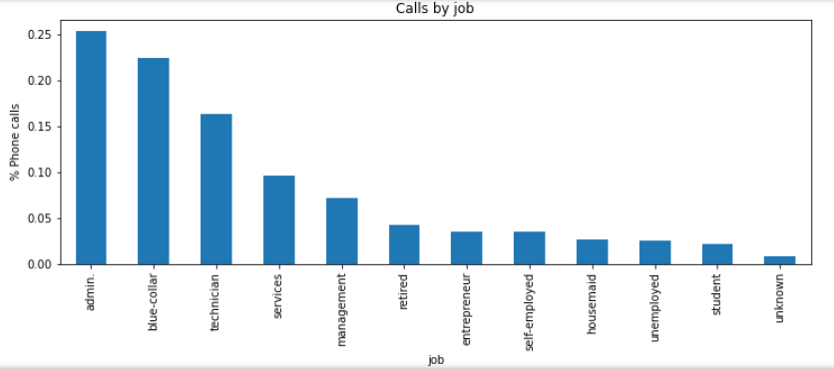
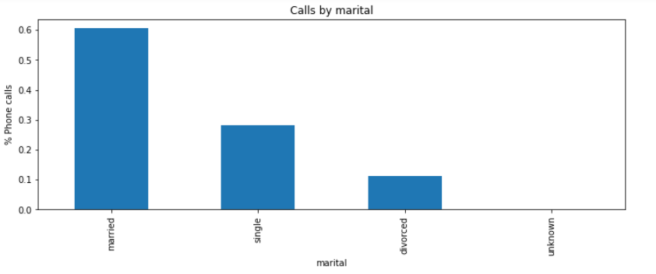
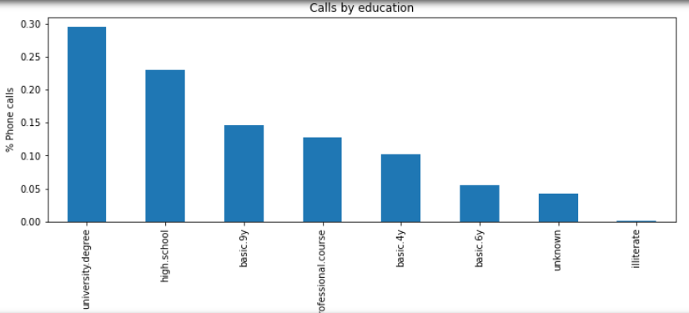
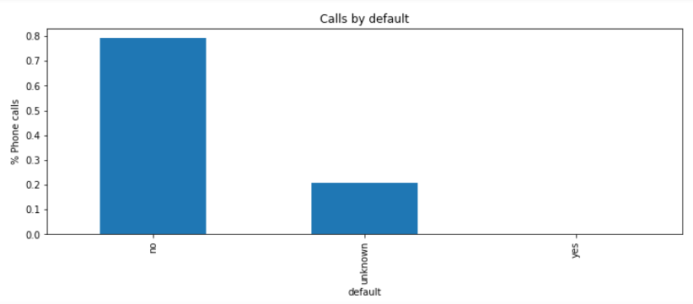
Market Overview – Categorical Variable Analysis
Notes:
There are some points to be noted from the categorical variables
1.
2.
3.
4.

Slide 11
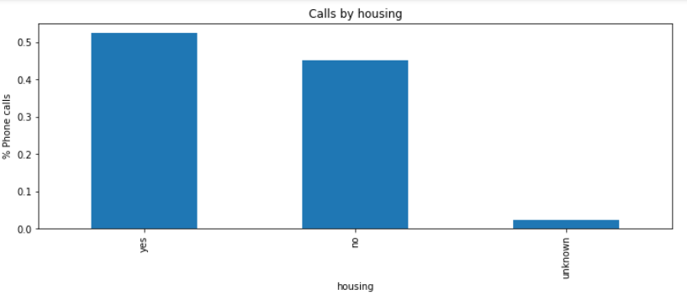
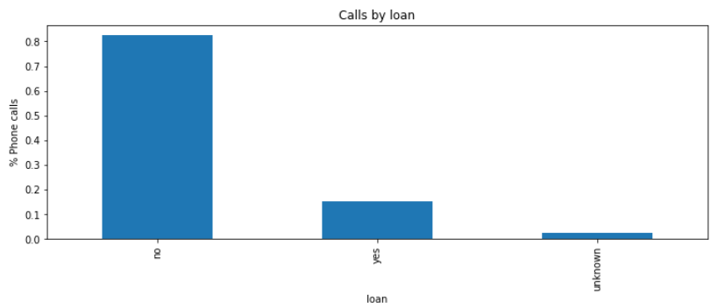
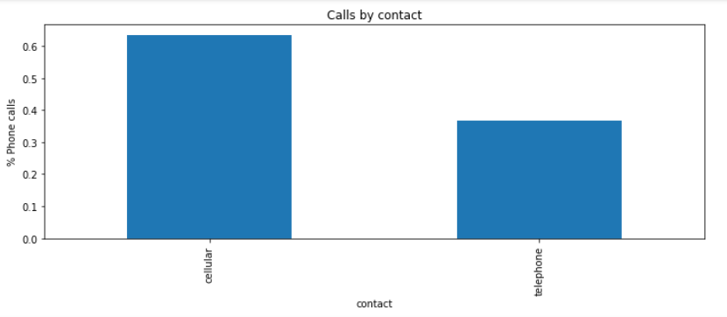
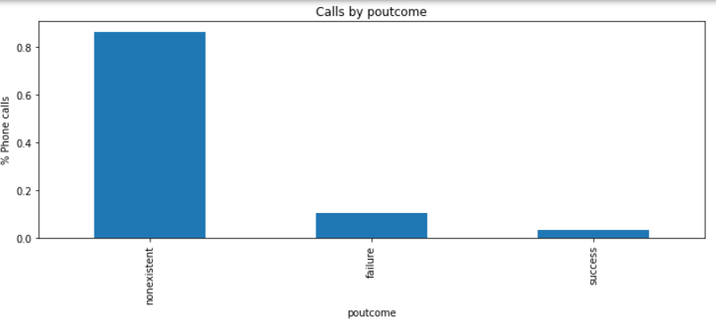
Market Overview – Categorical Variable Analysis
Notes:
There are some points to be noted from the categorical variables
1.
2.
3.
4.

Slide 12
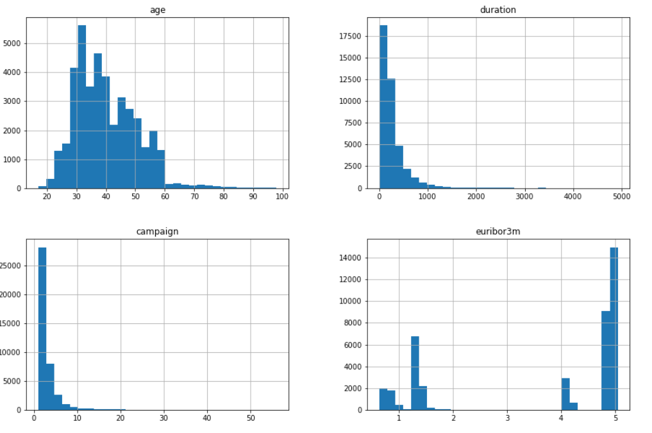
Market Overview – Numerical Variable Analysis
Notes:
There are some points to be noted from the continuous variables
1.

Slide 13
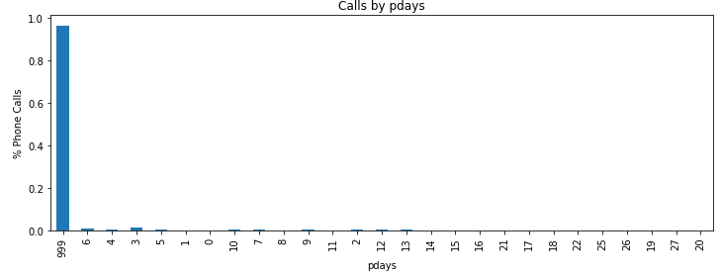
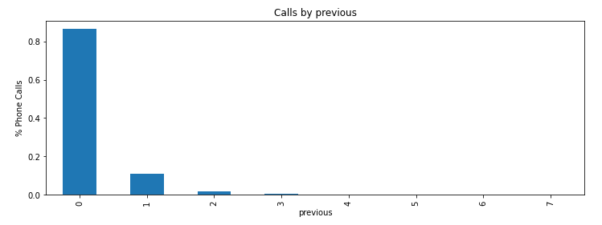
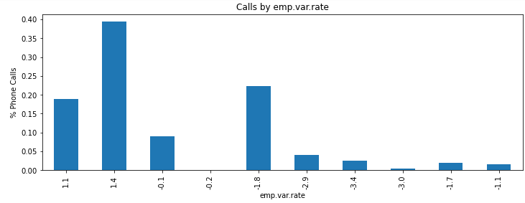
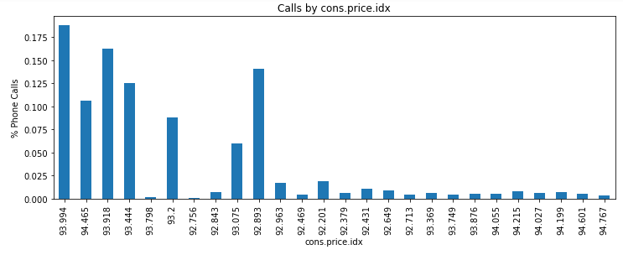
Market Overview – Numerical Variable Analysis
Notes:
Notes:
1.

Slide 14
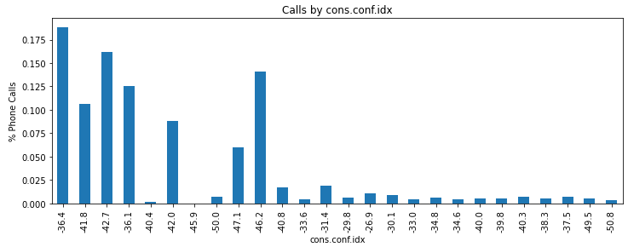
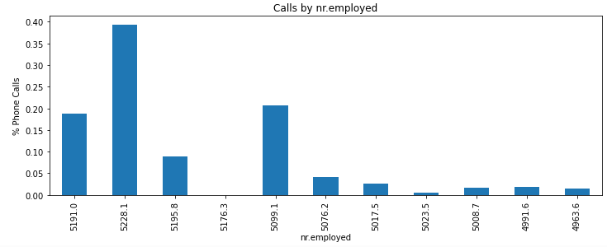
Market Overview – Numerical Variable Analysis
Notes:
Notes:
1.

Slide 15
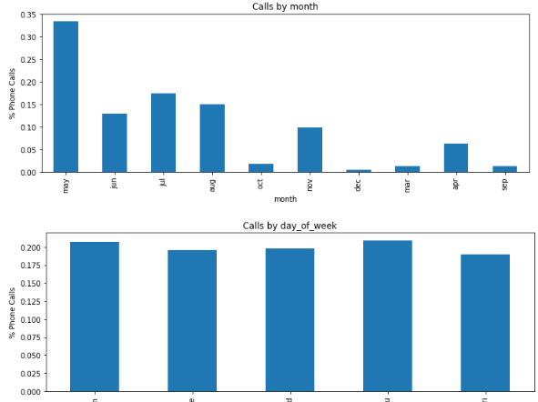
Temporal Variable Analysis

Slide 16
Missing and Unknown Value
In our dataset, we don’t have any missing value
For the Unknown value, we found five feature (job, education, default, housing and loan). Row number is relatively small so we dropped those rows.

Slide 17
Handle outlier
we are using box plot method to detect outlier. Outlier points = Q3 + 1.5 IQR(Upper Quartile) Q1 - 1.5 IQR(Lower Quartile)

Slide 18
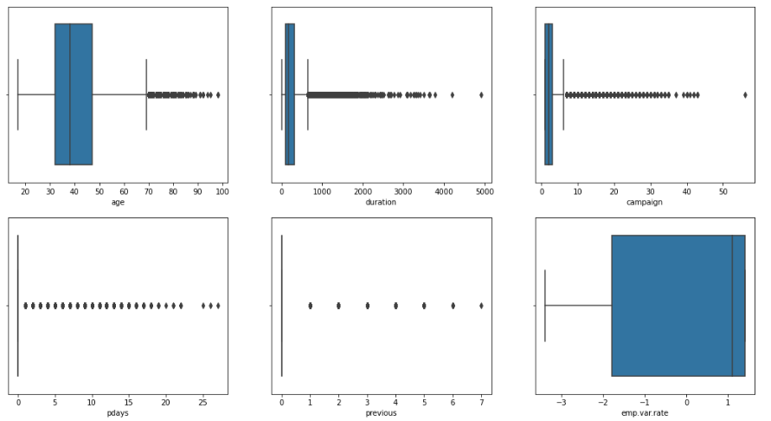
Box plot graph - I

Slide 19
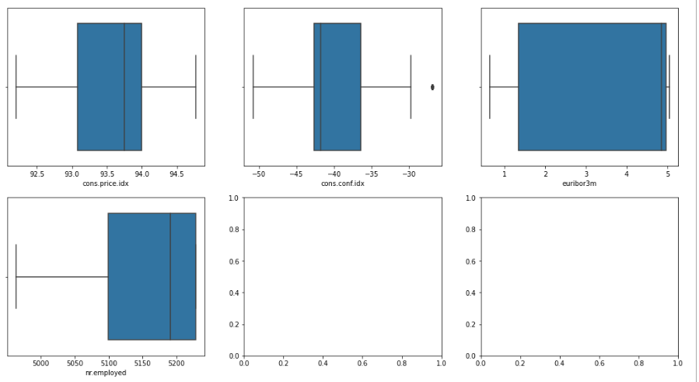
Box plot graph - II

Slide 20
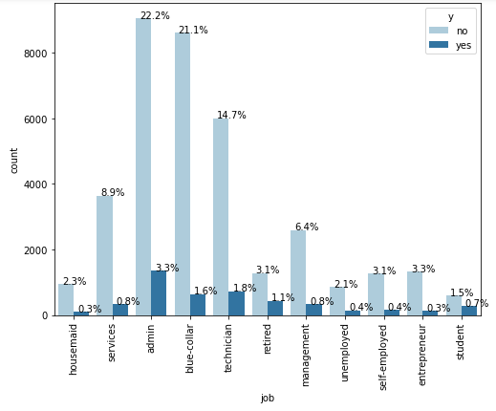
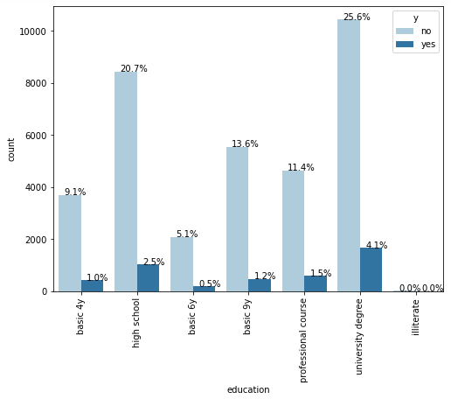
Categorical variable analysis - I

Slide 21
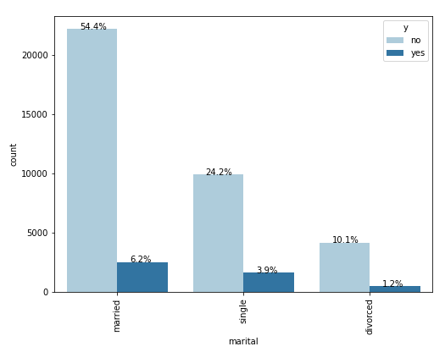
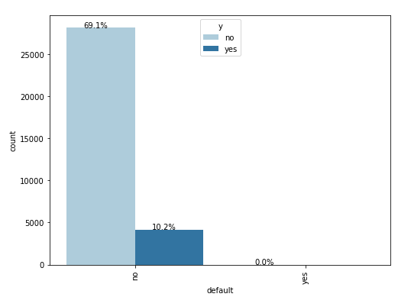
Categorical variable analysis - II

Slide 22
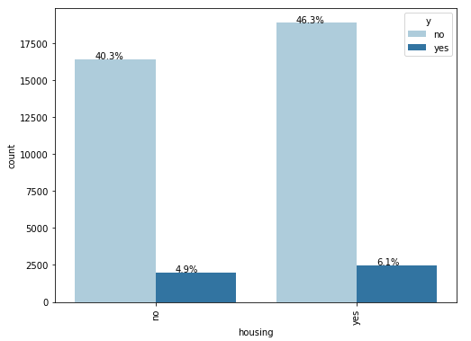
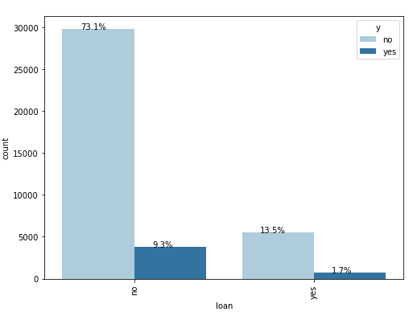
Categorical variable analysis - III

Slide 23
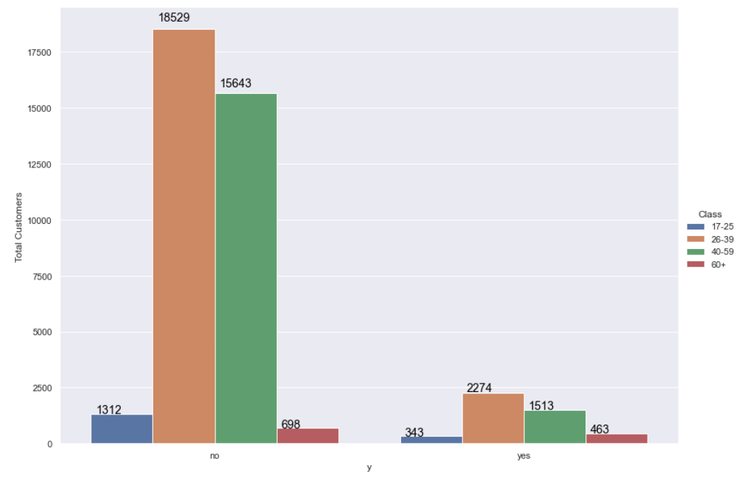
Target Variable Analysis – By Age Groups
Notes:
The age group 26-39 has been targeted the most by the campaign and therefore resulted in highest number of subscriptions. However, note that the conversion rate for elderly people 60+ is high and therefore they should be seen as an opportunity to be targeted by the campaign as they are the most vulnerable to the campaign.

Slide 24
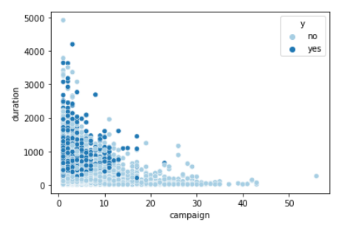
Correlation Analysis
Notes:
We see that as the campaign value increases the tendency of people to say ye to subscription decreases. After 25 contacts there is no person who has subscribed to the term deposit.

Slide 25
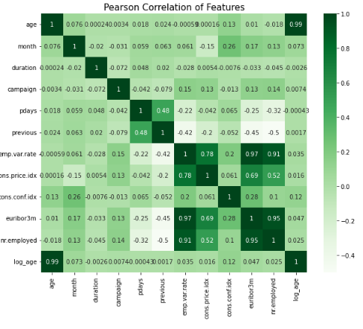
Correlation Analysis
Notes:
We see that as the campaign value increases the tendency of people to say ye to subscription decreases. After 25 contacts there is no person who has subscribed to the term deposit.

Slide 26
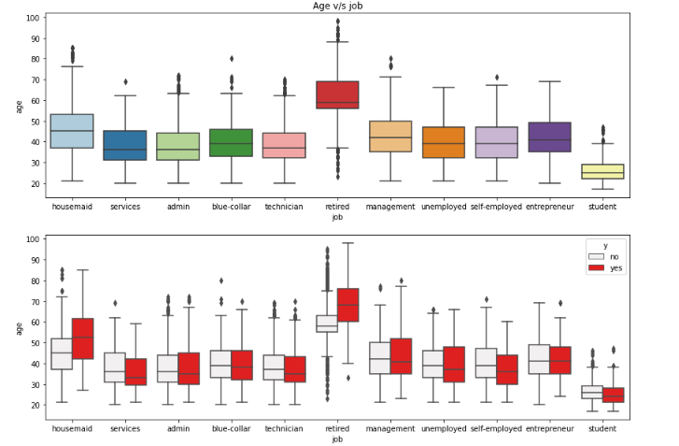
Age vs Job Analysis
Notes:
We see that as the campaign value increases the tendency of people to say ye to subscription decreases. After 25 contacts there is no person who has subscribed to the term deposit.

Slide 27
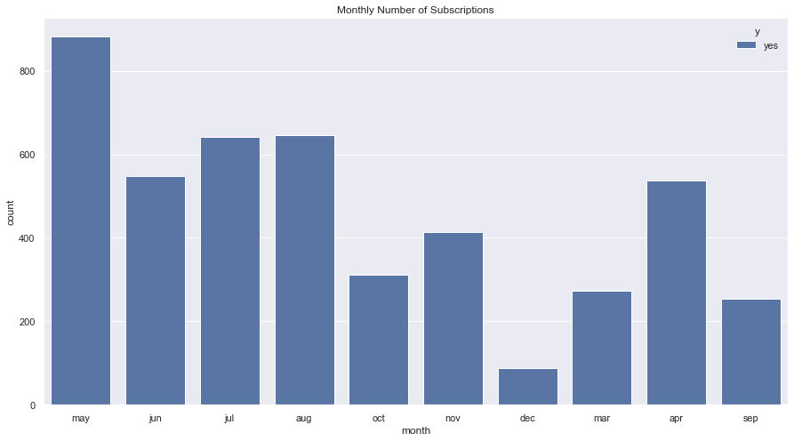
Time Series Analysis – Monthly Demand

Slide 28
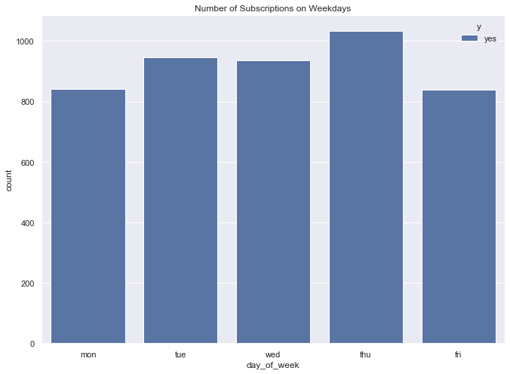
Time Series Analysis – Week Days Demand

Slide 29
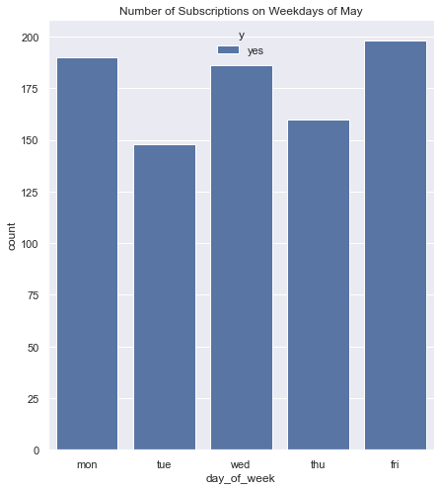
Time Series Analysis –Week-Day Demand of May

Slide 30

EDA Summary - Insights
May
26-39
Thursday
Cellular
Month with most subscribers
Age Group with most transactions
Day of the week with most subscribers
Best Mode of Contact

Slide 31
EDA Summary - Insights
May
26-39
Thursday
Cellular
Month with most subscribers
Age Group with most transactions
Day of the week with most subscribers
Best Mode of Contact

Slide 32
1. The outcome of a previous marketing campaign is a key feature for determining user behavior. If the previous campaign is successful then the user is more likely to subscribe than reject it. But if it is a failure then also some portion of the people still subscribe to the new one.
2. The people who are contacted through cellular have a higher conversion rate than telephone. Campaign should focuss more on cellular calls.
3. The people who are in default should not be contacted.
4. Retired and students people should be approached more as they show high conversion rate. However unemployed and housemaids should be contacted less as they show the lowest conversion rate.
5. Once the customer is contacted 25 times they should not be contacted further.
Recommendations

Slide 33
6. The older age group 60+ is more vulnerable to marketing campaign as they have a high conversion rate to subscription and therefore should be targeted more.
7. The more the customers are contacted the more they will subscribe. The efficiency of the salesmen should be supervised.
8. Mondays seem to have a lower conversion rate. The people should be contacted more on other days especially Thursdays.
9. There should be an increase in the contacts during March, September and October which shows promising conversion rate.
10. Thursdays of April seems to have an unusual large subscriptions. The reason behind this should be further investigated.
Recommendations

Slide 34
Logistic Regression
Neural Network
Random Forest
Model Proposal

Slide 35
Thank You!
Notes:
Thank you for your time. If you have any questions, please feel free to ask.

